Slide 1
Centrality in Social Networks
Background: At the individual level, one dimension of position in the network can be captured through centrality.
Conceptually, centrality is fairly straight forward: we want to identify which nodes are in the ‘center’ of the network. In practice, identifying exactly what we mean by ‘center’ is somewhat complicated.
Approaches:
    Degree
    Closeness
    Betweenness
    Information & Power
Graph Level measures: Centralization
Applications: (Day 2)
Friedkin: Interpersonal Influence in Groups
Alderson and Beckfield: World City Systems

Slide 2
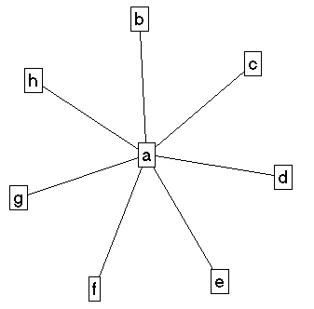
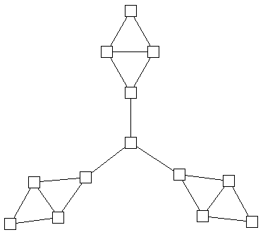
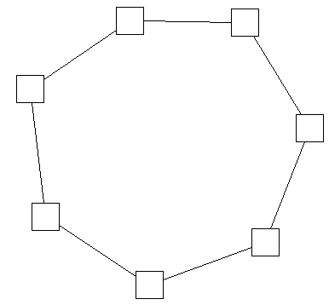
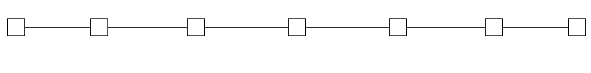
Centrality in Social Networks
Intuitively, we want a method that allows us to distinguish “important” actors. Consider the following graphs:

Slide 3
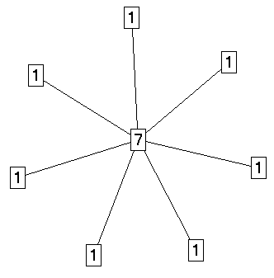
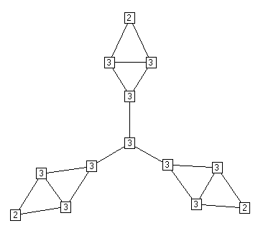
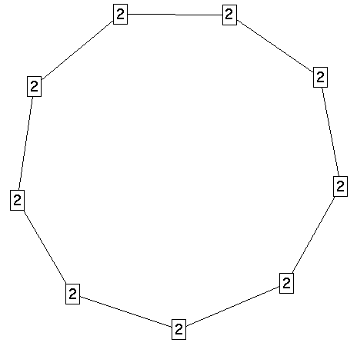

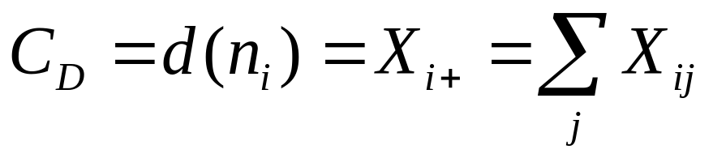
Centrality in Social Networks
Degree
The most intuitive notion of centrality focuses on degree: The actor with the most ties is the most important:

Slide 4
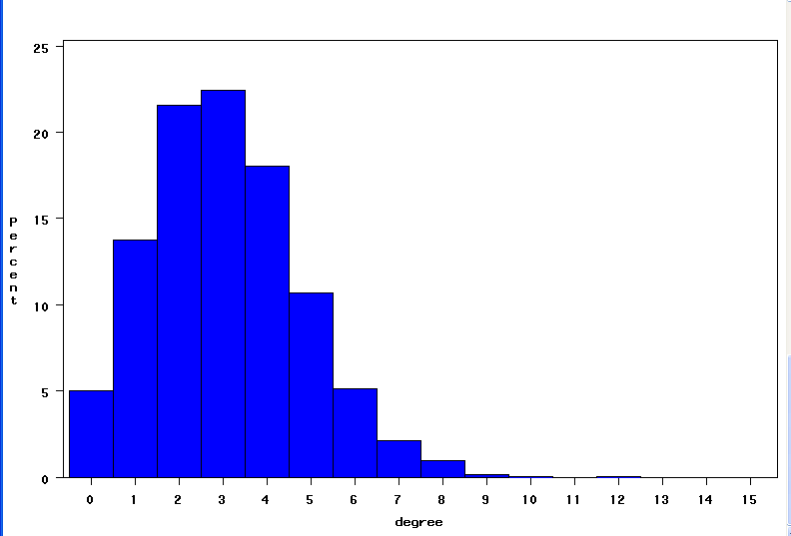
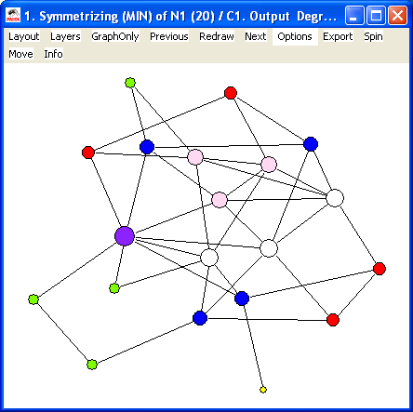
Centrality in Social Networks
Degree
In a simple random graph (Gn,p), degree will have a Poisson distribution, and the nodes with high degree are likely to be at the intuitive center. Deviations from a Poisson distribution suggest non-random processes, which is at the heart of current “scale-free” work on networks (see below).

Slide 5
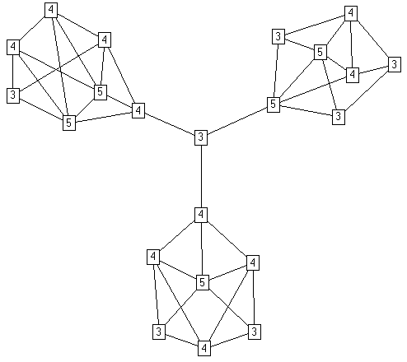
Centrality in Social Networks
Degree
Degree centrality, however, can be deceiving, because it is a purely local measure.

Slide 6
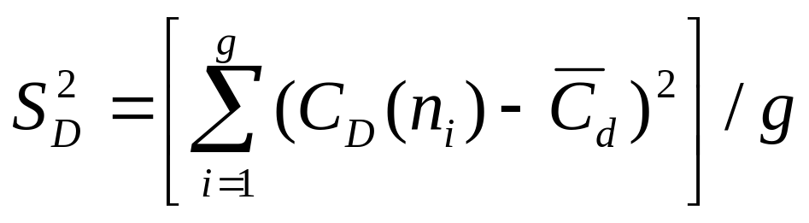
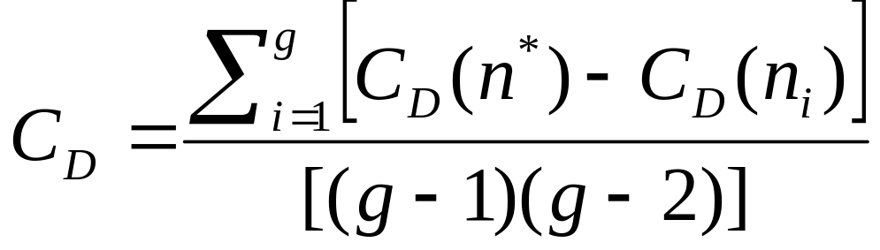
Centrality in Social Networks
Degree
If we want to measure the degree to which the graph as a whole is centralized, we look at the dispersion of centrality:
Simple: variance of the individual centrality scores.
Or, using Freeman’s general formula for centralization (which ranges from 0 to 1):
UCINET, SPAN, PAJEK and most other network software will calculate these measures.

Slide 7
Centrality in Social Networks
Degree
Degree Centralization Scores
Freeman: 1.0
Variance: 3.9
Freeman: 0.0
Variance: 0.0
Freeman: .02
Variance: .17
Freeman: .07
Variance: .20

Slide 8
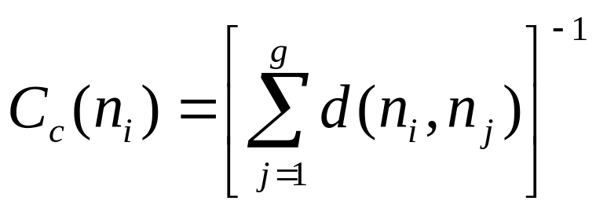
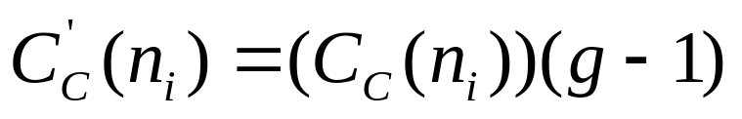
Centrality in Social Networks
Closeness
A second measure of centrality is closeness centrality. An actor is considered important if he/she is relatively close to all other actors.
Closeness is based on the inverse of the distance of each actor to every other actor in the network.
Closeness Centrality:
Normalized Closeness Centrality

Slide 9
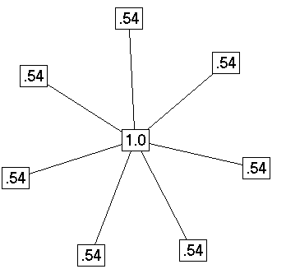
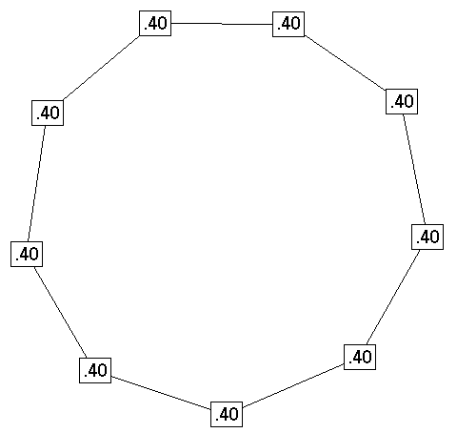
Centrality in Social Networks
Closeness
Closeness Centrality in the examples
Distance Closeness normalized
0 1 1 1 1 1 1 1 .143 1.00
1 0 2 2 2 2 2 2 .077 .538
1 2 0 2 2 2 2 2 .077 .538
1 2 2 0 2 2 2 2 .077 .538
1 2 2 2 0 2 2 2 .077 .538
1 2 2 2 2 0 2 2 .077 .538
1 2 2 2 2 2 0 2 .077 .538
1 2 2 2 2 2 2 0 .077 .538
Distance Closeness normalized
0 1 2 3 4 4 3 2 1 .050 .400
1 0 1 2 3 4 4 3 2 .050 .400
2 1 0 1 2 3 4 4 3 .050 .400
3 2 1 0 1 2 3 4 4 .050 .400
4 3 2 1 0 1 2 3 4 .050 .400
4 4 3 2 1 0 1 2 3 .050 .400
3 4 4 3 2 1 0 1 2 .050 .400
2 3 4 4 3 2 1 0 1 .050 .400
1 2 3 4 4 3 2 1 0 .050 .400

Slide 10
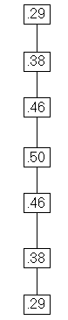
Centrality in Social Networks
Degree
Closeness Centrality in the examples
Distance Closeness normalized
0 1 2 3 4 5 6 .048 .286
1 0 1 2 3 4 5 .063 .375
2 1 0 1 2 3 4 .077 .462
3 2 1 0 1 2 3 .083 .500
4 3 2 1 0 1 2 .077 .462
5 4 3 2 1 0 1 .063 .375
6 5 4 3 2 1 0 .048 .286

Slide 11
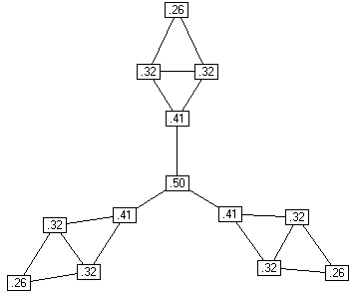
Centrality in Social Networks
Degree
Closeness Centrality in the examples
Distance Closeness normalized
0 1 1 2 3 4 4 5 5 6 5 5 6 .021 .255
1 0 1 1 2 3 3 4 4 5 4 4 5 .027 .324
1 1 0 1 2 3 3 4 4 5 4 4 5 .027 .324
2 1 1 0 1 2 2 3 3 4 3 3 4 .034 .414
3 2 2 1 0 1 1 2 2 3 2 2 3 .042 .500
4 3 3 2 1 0 2 3 3 4 1 1 2 .034 .414
4 3 3 2 1 2 0 1 1 2 3 3 4 .034 .414
5 4 4 3 2 3 1 0 1 1 4 4 5 .027 .324
5 4 4 3 2 3 1 1 0 1 4 4 5 .027 .324
6 5 5 4 3 4 2 1 1 0 5 5 6 .021 .255
5 4 4 3 2 1 3 4 4 5 0 1 1 .027 .324
5 4 4 3 2 1 3 4 4 5 1 0 1 .027 .324
6 5 5 4 3 2 4 5 5 6 1 1 0 .021 .255

Slide 12
Centrality in Social Networks
Betweenness
Betweenness Centrality:
Model based on communication flow: A person who lies on communication paths can control communication flow, and is thus important. Betweenness centrality counts the number of shortest paths between i and k that actor j resides on.
b
a
C d e f g h

Slide 13
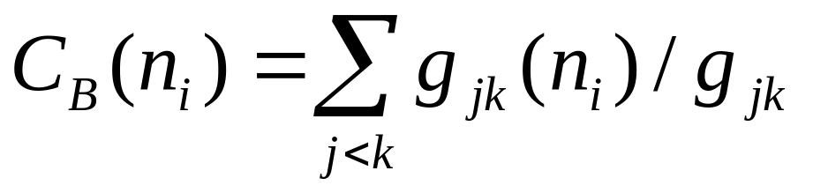
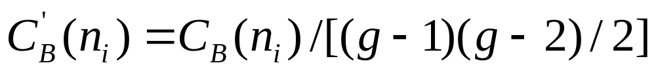
Centrality in Social Networks
Betweenness
Betweenness Centrality:
Where gjk = the number of geodesics connecting jk, and
gjk(ni) = the number that actor i is on.
Usually normalized by:

Slide 14
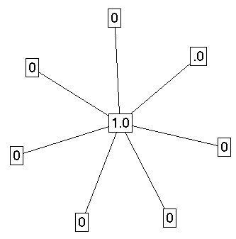


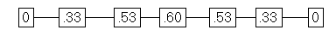
Centrality in Social Networks
Betweenness
Betweenness Centrality:
Centralization: 1.0
Centralization: .59
Centralization: 0
Centralization: .31

Slide 15
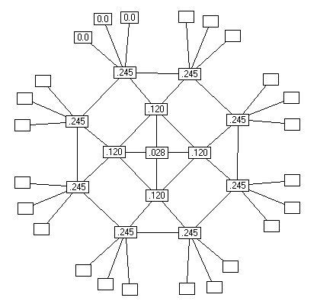
Centrality in Social Networks
Betweenness
Betweenness Centrality:
Centralization: .183

Slide 16
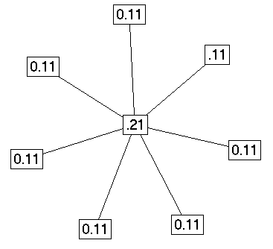
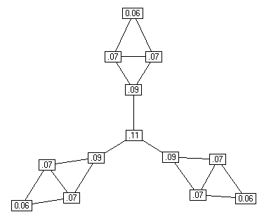
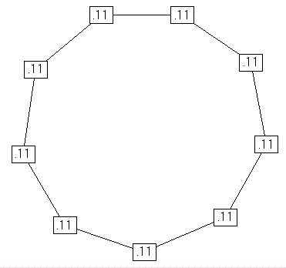
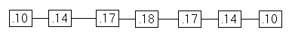
Centrality in Social Networks
Information
Information Centrality:
It is quite likely that information can flow through paths other than the geodesic. The Information Centrality score uses all paths in the network, and weights them based on their length.

Slide 17
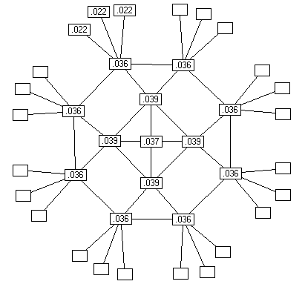
Centrality in Social Networks
Information
Information Centrality:

Slide 18
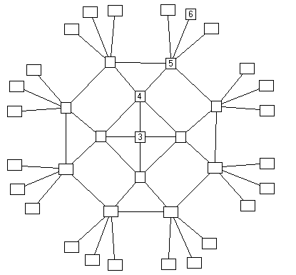
Centrality in Social Networks
Graph Theoretic Center
Graph Theoretic Center (Barry or Jordan Center). Identify the point(s) with the smallest, maximum distance to all other points.
Value = longest distance to any other node.
The graph theoretic center is ‘3’, but you might also consider a continuous measure as the inverse of the maximum geodesic

Slide 19
Centrality in Social Networks
Comparison
Comparing across these 3 centrality values
  Generally, the 3 centrality types will be positively correlated
  When they are not (low) correlated, it probably tells you something interesting about the network.
Low
Degree
Low
Closeness
Low
Betweenness
High Degree
Embedded in cluster that is far from the rest of the network
Ego's connections are redundant - communication bypasses him/her
High Closeness
Key player tied to important important/active alters
Probably multiple paths in the network, ego is near many people, but so are many others
High Betweenness
Ego's few ties are crucial for network flow
Very rare cell. Would mean that ego monopolizes the ties from a small number of people to many others.

Slide 20
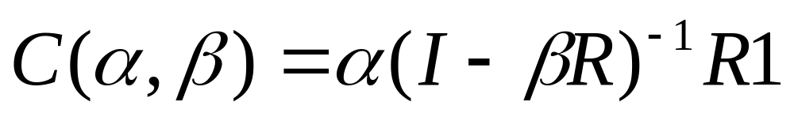
Centrality in Social Networks
Power / Eigenvalue
Bonacich Power Centrality: Actor’s centrality (prestige) is equal to a function of the prestige of those they are connected to. Thus, actors who are tied to very central actors should have higher prestige/ centrality than those who are not.
α is a scaling vector, which is set to normalize the score.
β reflects the extent to which you weight the centrality of people ego is tied to.
R is the adjacency matrix (can be valued)
I is the identity matrix (1s down the diagonal)
1 is a matrix of all ones.

Slide 21
Centrality in Social Networks
Power / Eigenvalue
Bonacich Power Centrality:
The magnitude of β reflects the radius of power. Small values of β weight local structure, larger values weight global structure.
If β is positive, then ego has higher centrality when tied to people who are central.
If β is negative, then ego has higher centrality when tied to people who are not central.
As β approaches zero, you get degree centrality.

Slide 22
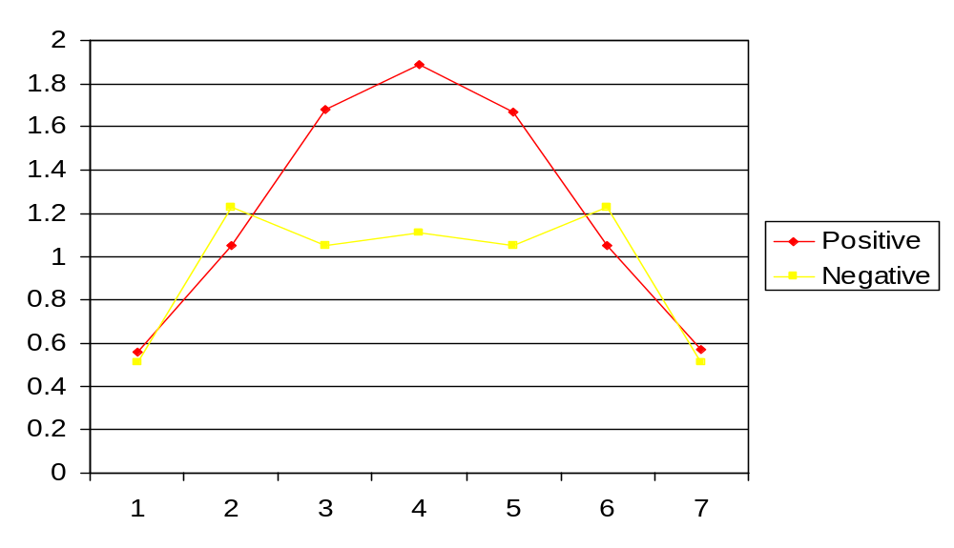
Centrality in Social Networks
Power / Eigenvalue
Bonacich Power Centrality:
β = 0.23

Slide 23
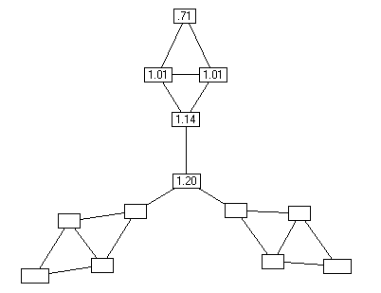

Centrality in Social Networks
Power / Eigenvalue
Bonacich Power Centrality:
β=.35
β=-.35

Slide 24

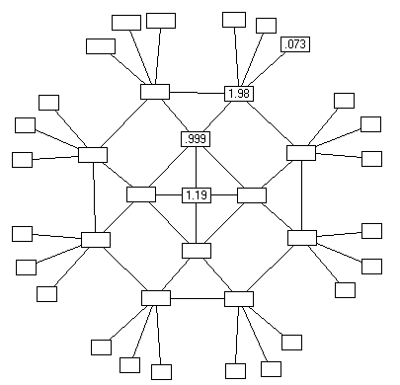
Centrality in Social Networks
Power / Eigenvalue
Bonacich Power Centrality:
β=.23
β= -.23

Slide 25
Centrality in Social Networks
Power / Eigenvalue
In recent work, Borgatti (2003; 2005) discusses centrality in terms of two key dimensions:
Radial
Medial
Frequency
Degree Centrality
Bon. Power centrality
Betweenness
Distance
(empty: but would be an interruption measure based on distance)
Closeness Centrality

Slide 26
Centrality in Social Networks
Power / Eigenvalue
In recent work, Borgatti (2003; 2005) discusses centrality in terms of two key dimensions:
Substantively, the key question for centrality is knowing what is flowing through the network. The key features are:
  Whether the actor retains the good to pass to others (Information, Diseases) or whether they pass the good and then loose it (physical objects)
  Whether the key factor for spread is distance (disease with low p_{ij}) or multiple sources (information)
  The off-the-shelf measures do not always match the social process of interest, so researchers need to be mindful of this.

Slide 27
Centrality in Social Networks
Other Options
There are other options, usually based on generalizing some aspect of those above:
  Random Walk Betweenness (Mark Newman). Looks at the number of times you would expect node I to be on the path between k and j if information traveled a ‘random walk’ through the network.
  Peer Influence based measures (Friedkin and others). Based on the assume network autocorrelation model of peer influence. In practice it’s a variant of the eigenvector centrality measures.
  Subgraph centrality. Counts the number of cliques of size 2, 3, 4, … n-1 that each node belongs to. Reduces to (another) function of the eigenvalues. Very similar to influence & information centrality, but does distinguish some unique positions.
  Fragmentation centrality – Part of Borgatti’s Key Player idea, where nodes are central if they can easily break up a network.
  Moody & White’s Embeddedness measure is technically a group-level index, but captures the extent to which a given set of nodes are nested inside a network

Slide 28
Noah Friedkin: Structural bases of interpersonal influence in groups
Interested in identifying the structural bases of power. In addition to resources, he identifies:
  Cohesion
  Similarity
  Centrality
Which are thought to affect interpersonal visibility and salience

Slide 29
Noah Friedkin: Structural bases of interpersonal influence in groups
Cohesion
Members of a cohesive group are likely to be aware of each others opinions, because information diffuses quickly within the group.
Groups encourage (through balance) reciprocity and compromise. This likely increases the salience of opinions of other group members, over non-group members.
Actors P and O are structurally cohesive if they are joint members of a cohesive group. The greater their cohesion, the more likely they are to influence each other.
Note some of the other characteristics he identifies (p.862):
  Inclination to remain in the group
  Members capacity for social control and collective action
  Are these useful indicators of cohesion?

Slide 30
Noah Friedkin: Structural bases of interpersonal influence in groups
Structural Similarity
Two people may not be directly connected, but occupy a similar position in the structure. As such, they have similar interests in outcomes that relate to positions in the structure.
Similarity must be conditioned on visibility. P must know that O is in the same position, which means that the effect of similarity might be conditional on communication frequency.

Slide 31
Noah Friedkin: Structural bases of interpersonal influence in groups
Centrality
Central actors are likely more influential. They have greater access to information and can communicate their opinions to others more efficiently. Research shows they are also more likely to use the communication channels than are periphery actors.

Slide 32
Noah Friedkin: Structural bases of interpersonal influence in groups
French & Raven propose alternative bases for dyadic power:
Reward power, based on P’s perception that O has the ability to mediate rewards
Coercive power – P’s perception that O can punish
Legitimate power – based on O’s legitimate right to power
Referent power – based on P’s identification w. O
Expert power – based on O’s special knowledge
Friedkin created a matrix of power attribution, bk, where the ij entry = 1 if person i says that person j has this base of power.

Slide 33
Noah Friedkin: Structural bases of interpersonal influence in groups
Substantive questions: Influence in establishing school performance criteria.
Data on 23 teachers
collected in 2 waves
Dyads are the unit of analysis (P--> O): want to measure the extent of influence of one actor on another.
Each teacher identified how much an influence others were on their opinion about school performance criteria.
Cohesion = probability of a flow of events (communication) between them, within 3 steps.
Similarity = pairwise measure of equivalence (profile correlations)
Centrality = TEC (power centrality)

Slide 34
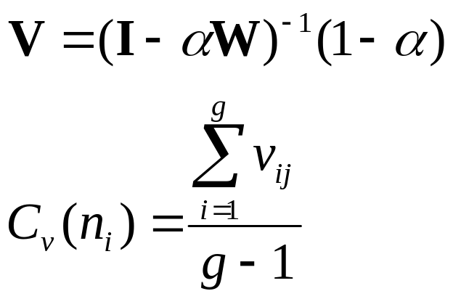
Total Effects Centrality (Friedkin).
Very similar to the Bonacich measure, it is based on an assumed peer influence model.
The formula is:
Where W is a row-normalized adjacency matrix, and α is a weight for the amount of interpersonal influence

Slide 35
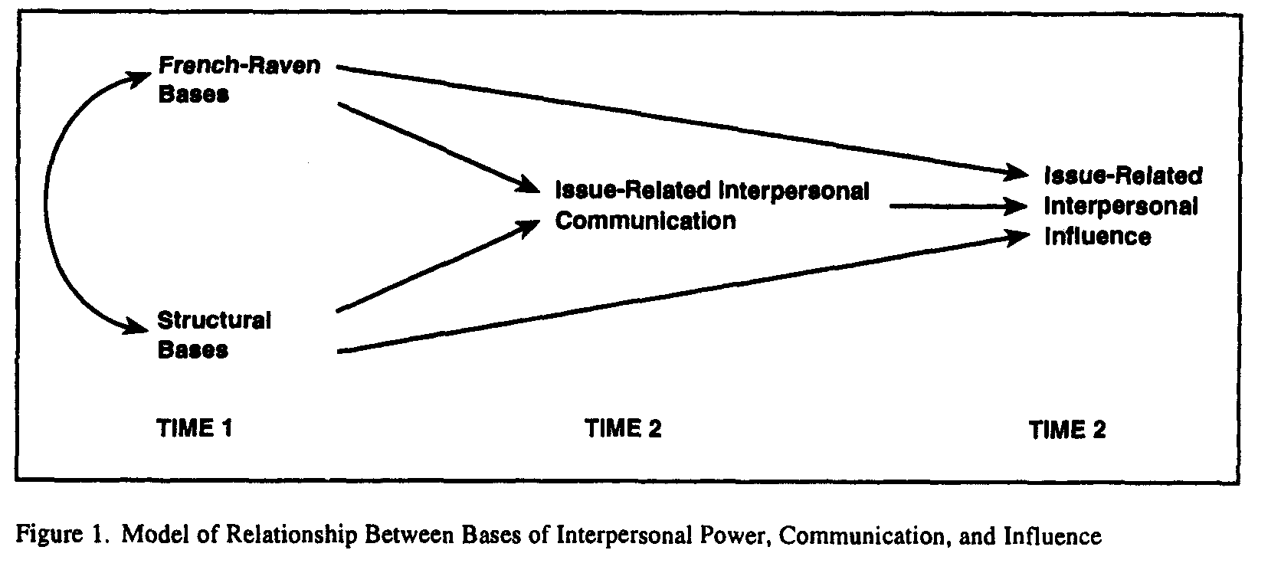
Noah Friedkin: Structural bases of interpersonal influence in groups
+
+
+
Find that each matter for interpersonal communication, and that communication is what matters most for interpersonal influence.

Slide 36
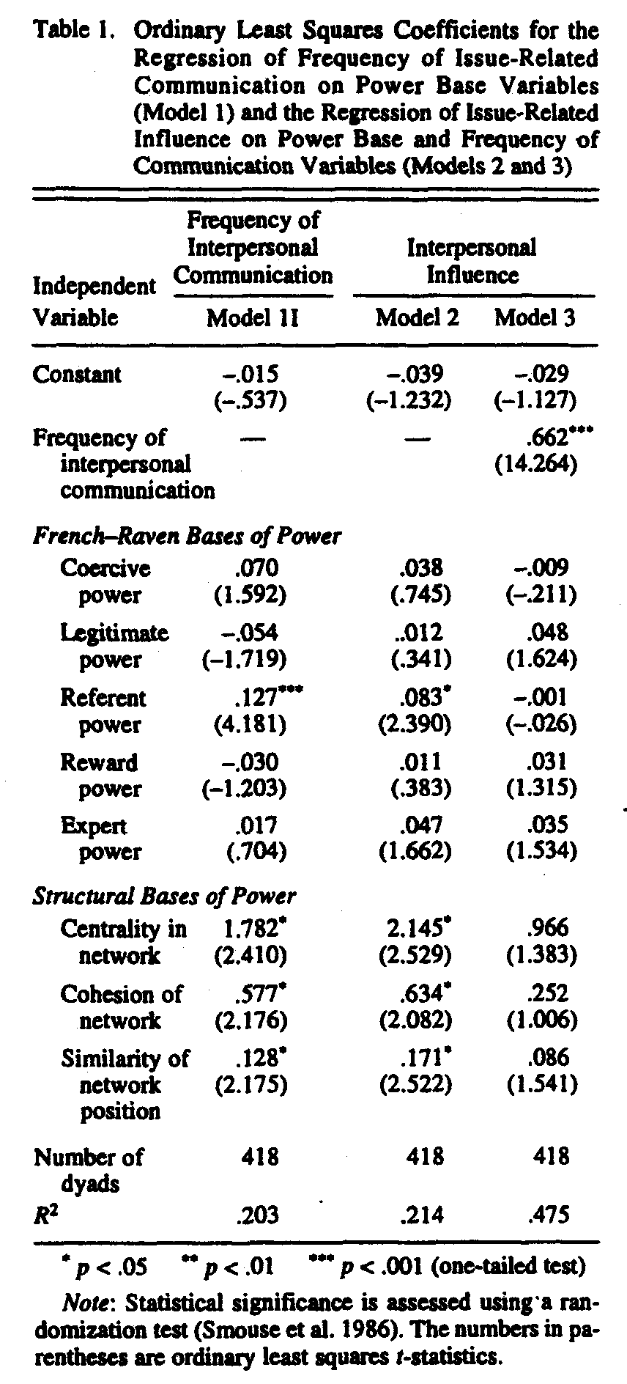
Noah Friedkin: Structural bases of interpersonal influence in groups

Slide 37
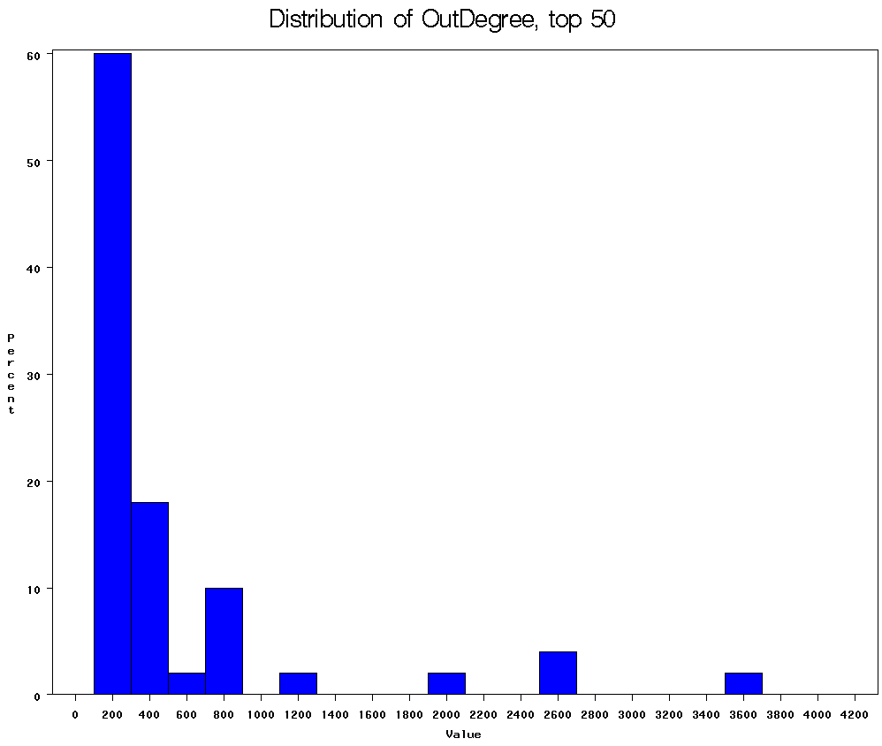
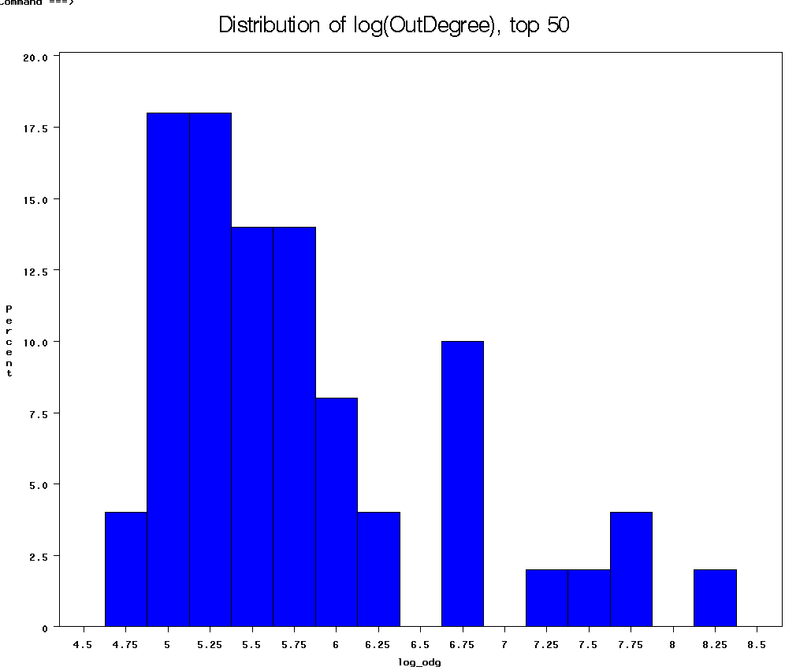
World City System

Slide 38
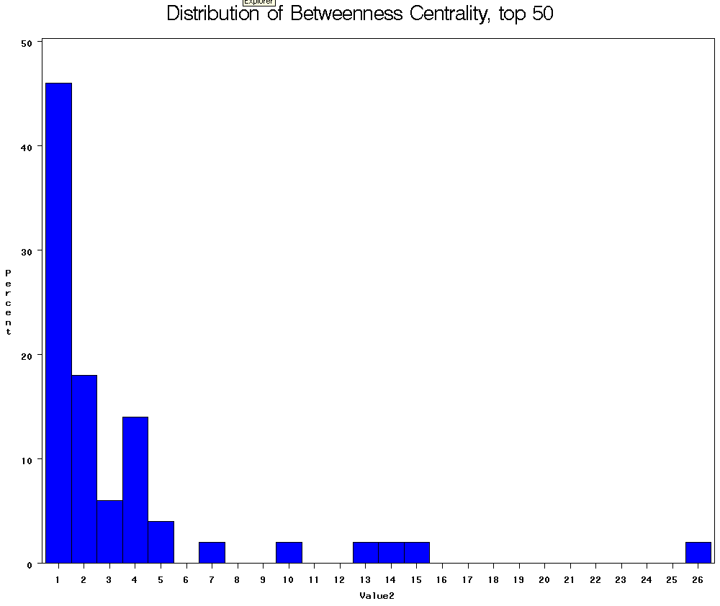
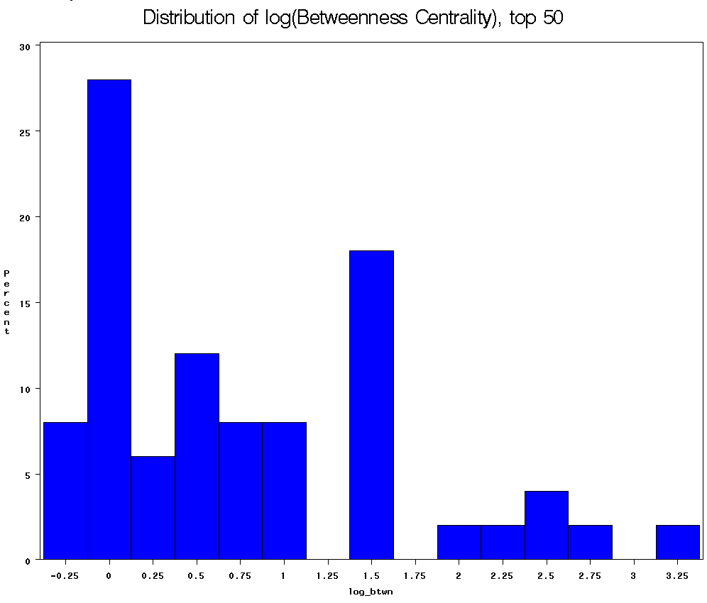
World City System

Slide 39
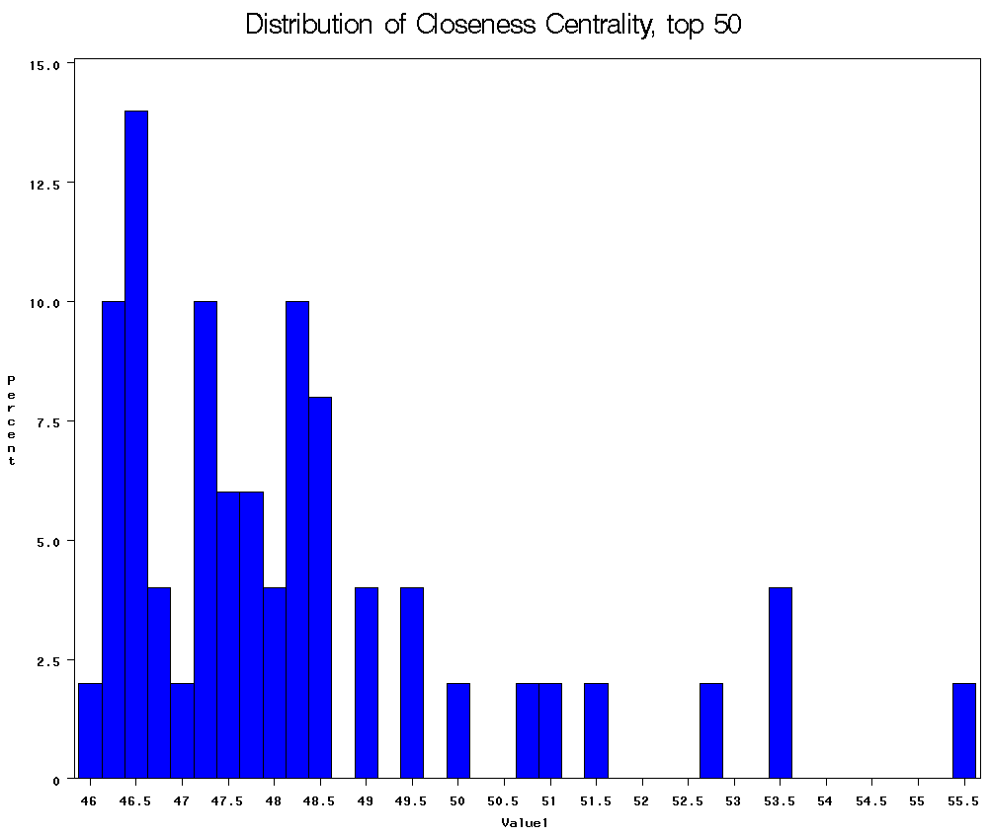
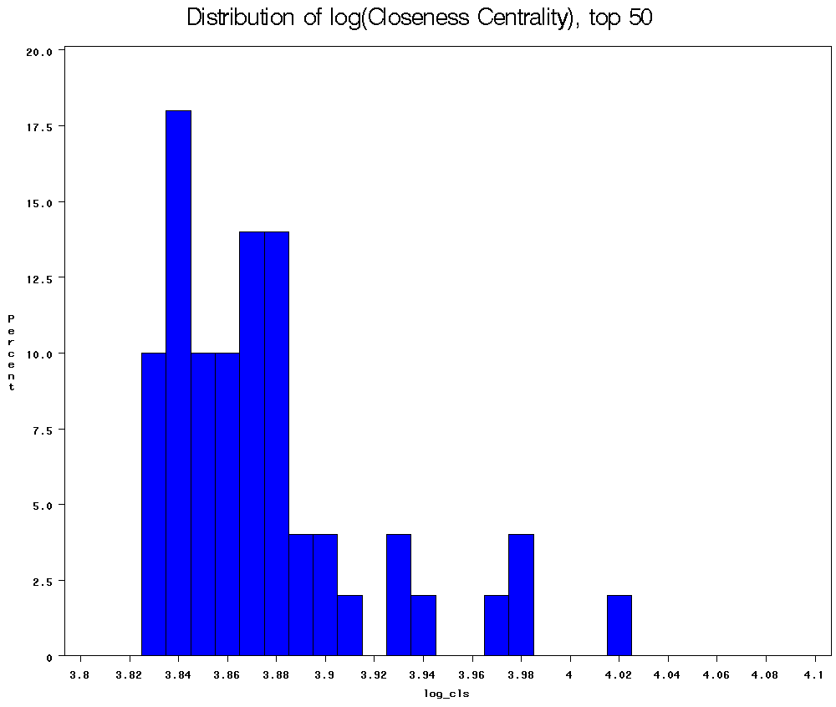
World City System

Slide 40
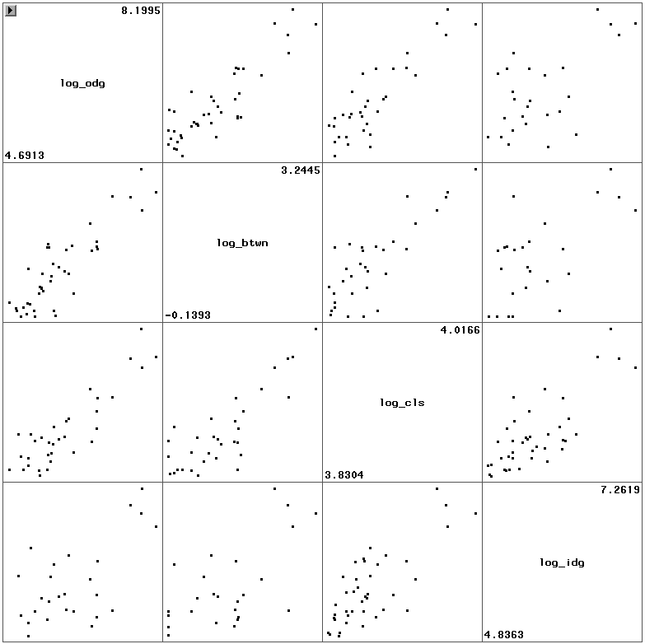
World City System
Relation among centrality measures (from table 3)
Ln(out-degree)
r=0.88
N=41
Ln(Betweenness)
r=0.88
N=33
r=0.84
N=32
Ln(Closeness)
r=0.62
N=26
r=0.62
N=25
r=0.78
N=40
Ln(In-Degree)

Slide 41
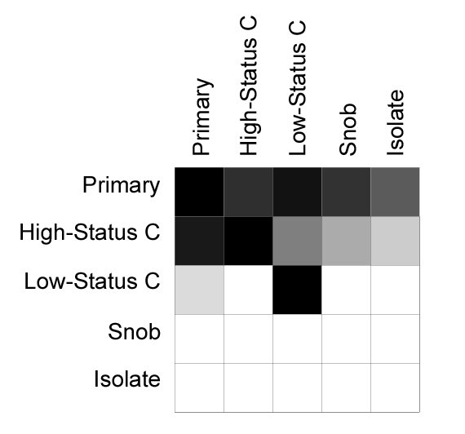
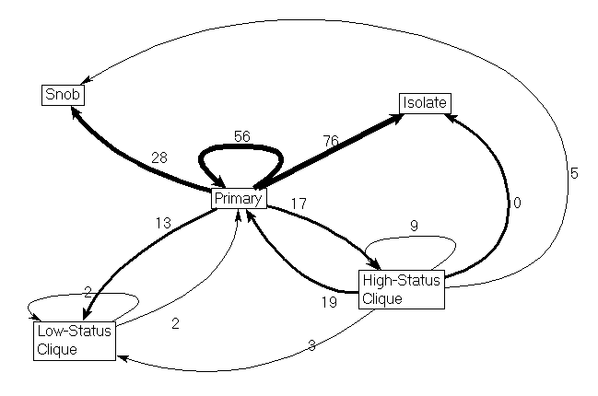
World City System

Slide 42
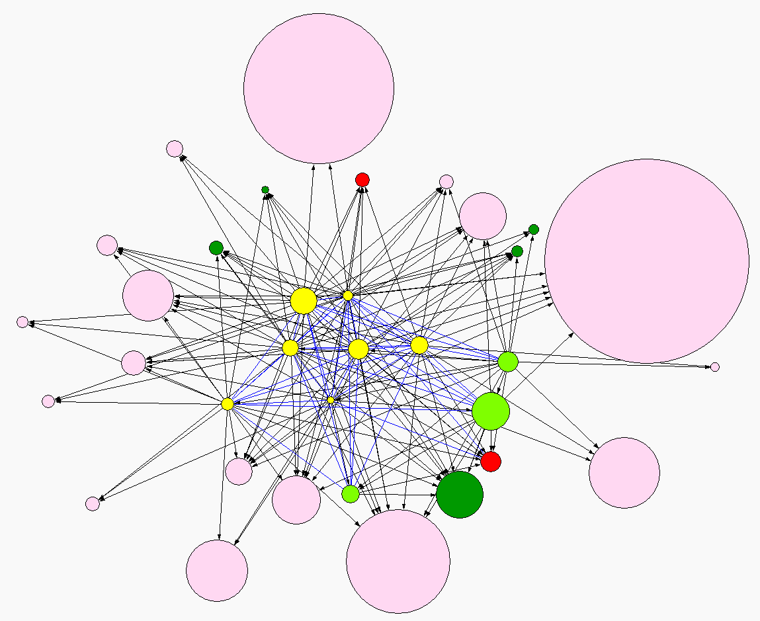
World City System

Slide 43
Baker & Faulkner: Social Organization of Conspiracy
Questions: How are relations organized to facilitate illegal behavior?
They show that the pattern of communication maximizes concealment, and predicts the criminal verdict.
Inter-organizational cooperation is common, but too much ‘cooperation’ can thwart market competition, leading to (illegal) market failure.
Illegal networks differ from legal networks, in that they must conceal their activity from outside agents. A “Secret society” should be organized to (a) remain concealed and (b) if discovered make it difficult to identify who is involved in the activity
The need for secrecy should lead conspirators to conceal their activities by creating sparse and decentralized networks.

Slide 44
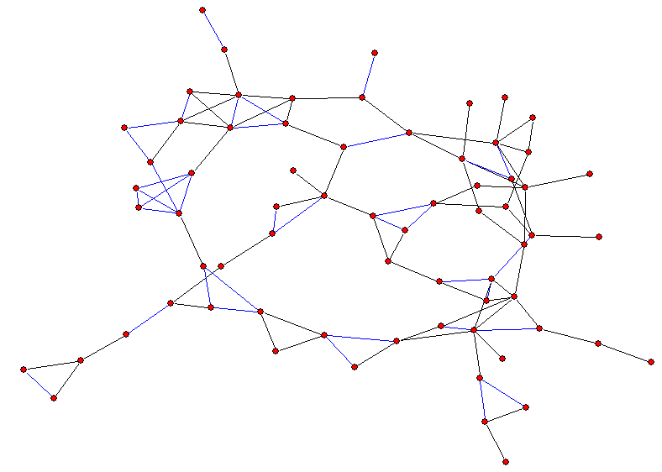
Baker & Faulkner: Social Organization of Conspiracy
Secrets in a Southern Sorority:

Slide 45
Baker & Faulkner: Social Organization of Conspiracy
Basic Theoretical Approaches:
  Industrial Organization Economics
    Number of buyers / sellers,etc. matter for the development of collusion.
  Organizational Crime
    - Focus on individuals acting as agents, in that crimes benefit the organization, not the individual.
  Network Approach
    Focus on the firm’s network connections
    These connections can form constraints on behavior
    While legal, “…linkages between competing units tend to be viewed with suspicion”
    Heavy Electrical equipment industry forms these kinds of networks.
    The need for secrecy should create sparse and decentralized networks, but coordination requires density

Slide 46
Baker & Faulkner: Social Organization of Conspiracy
Structure of Illegal networks
If task efficiency were all that mattered:
  Low information → centralized communication nets
  High information → decentralization
If task secrecy is paramount,then all should be decentralized

Slide 47
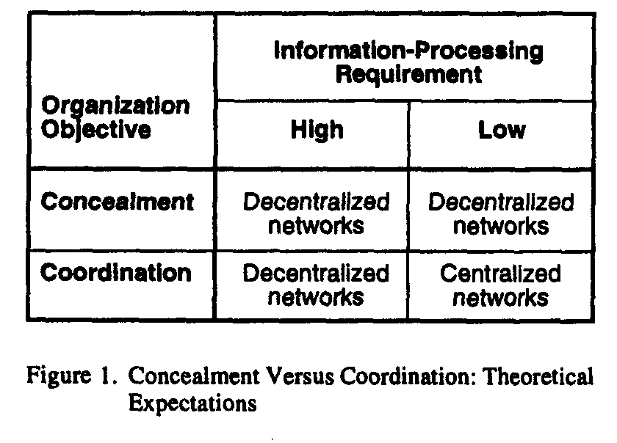
Baker & Faulkner: Social Organization of Conspiracy

Slide 48
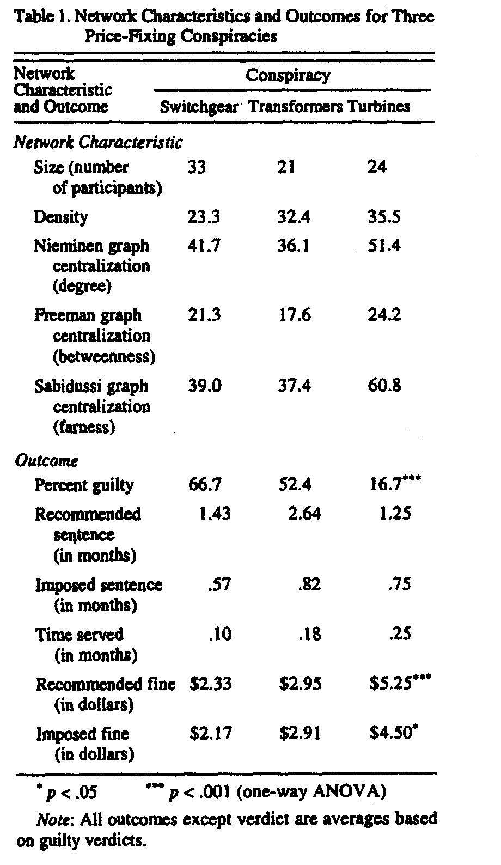
Baker & Faulkner: Social Organization of Conspiracy

Slide 49

Baker & Faulkner: Social Organization of Conspiracy

Slide 50

Baker & Faulkner: Social Organization of Conspiracy

Slide 51
From an individual standpoint, actors want to be central to get the benefits, but peripheral to remain concealed.
They examine the effect of Degree, Betweenness and Closeness centrality on the criminal outcomes, based on reconstruction of the communication networks involved.
At the organizational level, they find decentralized networks in the two low information-processing conspiracies, but high centralization in the other. Thus, a simple product can be organized without centralization.
At the individual level, that degree centrality (net of other factors) predicts verdict,

Slide 52
Secrecy
Low
High
Centralized
Decentralized
Low
Information
Decentralized
Centralized
High

